Slide 1
Automated testing and Test-Driven Development (TDD)
COMP6100001 - Software engineering
Session 20
Kenny Jingga, S.Kom., M.T.

Slide 2
Session 20 – Automated testing and Test-Driven Development (TDD)
Learning objectives
At the end of this session, students will be expected to be able to:
Understand the fundamentals and benefits of automated testing.
Explore popular test automation frameworks and tools.
Grasp the principles and practices of Test-Driven Development (TDD).
Implement TDD in projects and integrate it into continuous integration (CI) workflows.
Apply best practices for maintaining reliable automated tests.

Slide 3
Session 20 – Automated testing and Test-Driven Development (TDD)
Content outline
Introduction to Automated Testing
Benefits and Challenges of Automation
Test Automation Frameworks
Principles of Test-Driven Development (TDD)
Implementing TDD in Software Projects
Continuous Integration and Automated Testing Integration
Best Practices for Maintaining Automated Tests

Slide 4


Introduction to Automated Testing
Why?

Slide 5
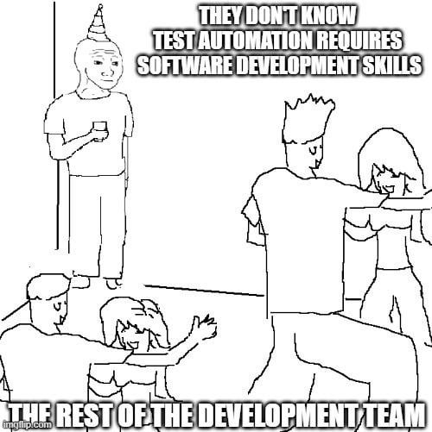
Introduction to Automated Testing
But..

Slide 6
Introduction to Automated Testing
Definition and Role of Automated Testing in Software Engineering
Automated testing is the process of using scripts or tools to execute pre-designed tests on software, which can validate functionality, performance, and other attributes automatically.
Example: Using a script to test login functionality automatically each time code is updated.
Role of Automated Testing in Software Engineering
Automated testing accelerates validation cycles and ensures consistency across tests, crucial for projects that follow Agile practices with frequent releases.

Slide 7
Introduction to Automated Testing
Types of Automated Tests
Unit Tests: Validate individual functions or methods.
Integration Tests: Verify interactions between components.
End-to-End (E2E) Tests: Test complete workflows, often from a user perspective.

Slide 8
Benefits and Challenges of Automation
Benefits of test Automation
Increased Testing Speed: Automated tests run faster than manual testing, saving time during the development process.
Improved Test Coverage: Automation enables broader coverage with repetitive testing across multiple scenarios.
Early Defect Detection: Automated tests can run with each code commit, catching defects early before they escalate.
Consistency and Reliability: Automation reduces human error, ensuring test results remain consistent.

Slide 9
Benefits and Challenges of Automation
Challenges of test Automation
Initial Setup Costs: High setup and maintenance costs for scripts, tools, and frameworks.
False Positives/Negatives: Poorly designed tests can lead to misleading results.
Maintenance Overhead: Tests must evolve as code changes, requiring regular updates to avoid test decay.
Not Suitable for All Tests: Manual exploratory tests remain essential for usability, UX, and edge cases.

Slide 10
Test Automation Frameworks
Role Of Test Automation Frameworks
Frameworks provide standardized tools and libraries to streamline writing, executing, and managing automated tests.
Examples of Popular Frameworks
  JUnit (Java):
    A popular unit testing framework for Java applications.
    Supports annotations (e.g., @Test, @Before, @After) for test setup and teardown.
    Example: Writing a simple unit test for a method that calculates the sum of two numbers.
  Selenium (Web Testing):
    A tool for automating web browser interactions, suitable for end-to-end testing of web applications.
    Allows testing of workflows like login, form submissions, and navigation.
    Example: Automating a test to validate form submission on a web page.
Choosing the Right Framework: Discuss factors to consider, such as the application type (web, mobile, desktop) and integration with CI tools.

Slide 11
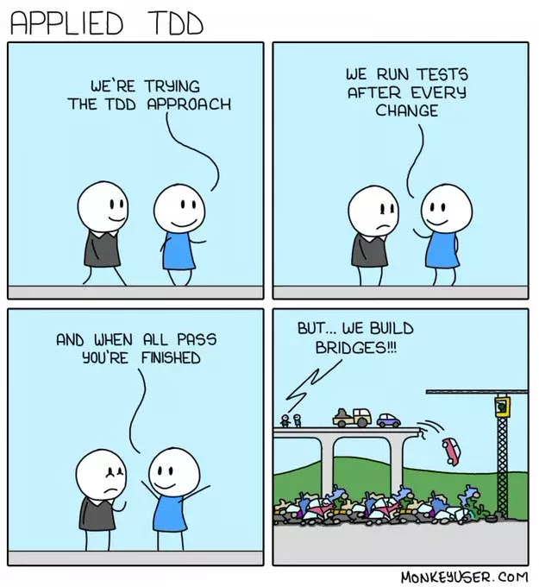
Principles of Test-Driven Development (TDD)
Definition of TDD
TDD is a development approach where tests are written before code, guiding the design and development process to meet specified behavior.

Slide 12
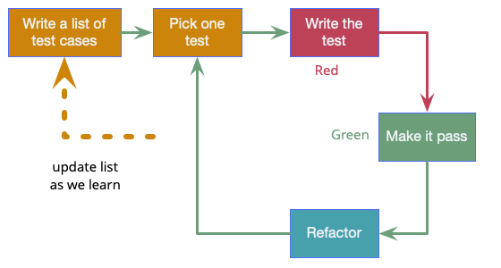
Principles of Test-Driven Development (TDD)
The TDD Cycle (Red-Green-Refactor)

Slide 13
Principles of Test-Driven Development (TDD)
The TDD Cycle (Red-Green-Refactor)
Red (Write a Failing Test):
  Start with a test that defines a small improvement or new feature. This initial test should fail as there's no existing code to make it pass.
Green (Write the Minimum Code):
  Write the minimum amount of code to make the failing test pass. The emphasis is on simplicity and meeting the test requirements.
Refactor (Improve the Code):
  Refactor the code without changing its behavior. The goal is to enhance the code's structure, readability, and efficiency while maintaining the passing test.
Example: TDD for a function that calculates factorials. Write a failing test for input, implement basic functionality to pass, and refine for edge cases.

Slide 14
Principles of Test-Driven Development (TDD)
Key TDD Principles
Small, Incremental Changes: Code is added in small, testable steps.
Focus on Requirements: Tests define specific behaviors to ensure code meets requirements.
Refactoring Confidence: Ensures safe refactoring without breaking functionality.

Slide 15
Implementing TDD in Software Projects
Basic TDD implementation
Setting Up TDD in a Project
  Establish a test framework, such as JUnit or PyTest.
  Define small, clear requirements to convert into tests.
Example Workflow:
  Step 1: Write a failing test for a function that returns the maximum of two numbers.
  Step 2: Implement the function to make the test pass.
  Step 3: Refactor the function if necessary and run tests again.
Tips for Successful TDD:
  Focus on one test at a time.
  Avoid over-engineering; only write code necessary to pass tests.
  Continually refactor to improve code quality.

Slide 16
Continuous Integration and Automated Testing Integration
CI Concepts
Continuous Integration (CI) is a practice where developers frequently integrate code into a shared repository. Automated tests are run as part of this process to detect integration issues early.
Integrating Automated Testing into CI
  Use CI tools (e.g., Jenkins, GitHub Actions, GitLab CI) to automatically trigger test runs on each commit.
  Example: Setting up GitHub Actions to run JUnit tests with each pull request.
Benefits of CI and Automated Testing Integration
  Immediate Feedback: Test failures are detected immediately, helping to resolve issues quickly.
  Improved Collaboration: Team members can check if new code impacts existing functionality.
  Reduced Risk of Integration Issues: Regular integration reduces last-minute issues.

Slide 17
Best Practices for Maintaining Automated Tests
Write Clear and Maintainable Tests: Use descriptive names for test cases and organize them logically for easy understanding.
Keep Tests Independent and Isolated: Ensure each test is independent to avoid order dependencies. This makes debugging easier and tests more reliable.
Regularly Review and Refactor Tests: As code evolves, tests need to be updated to reflect changes. Refactor to avoid outdated or redundant tests.
Balance Test Coverage with Practicality: Aim for meaningful coverage rather than striving for 100% coverage; focus on critical paths.
Manage Test Data and Environments Carefully: Consistent test data and stable environments are essential for reliable automated tests.
Example Scenario:
For a shopping cart feature, maintain independent tests for adding, removing, and updating items to ensure modularity and flexibility.

Slide 18



Best Practices for Maintaining Automated Tests
Be Careful…

Slide 19
References
Titus Winters, Tom Manshreck, and Hyrum Wright. (2020). Software Engineering at Google: Lesson Learned from Programming Over Time. 1st. O’Reilly Media. California. ISBN: 978-1492082798.
Roger Pressman and Bruce Maxim. (2020). Software Engineering: A Practitioner's Approach. 9th E. McGraw- Hill. New York. ISBN: 9781259872976.

